Slide 1

ShiftOps Architecture
A High-Stakes SaaS Platform for Critical Hospital Scheduling and Labor Compliance
ARCHITECTURAL STRATEGY REPORT

Slide 2

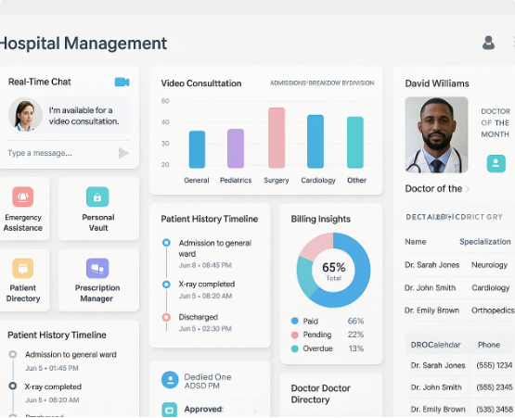
Mission-Critical Hospital Scheduling
Enforcing Safety & Compliance
ShiftOps is a multi-tenant SaaS designed for operational continuity in 24/7 hospital environments.
• Multi-Tenant Isolation: Dedicated schemas for hospital data integrity.
• Labor Act Guardrails: Real-time validation against the Bangladesh Labour Act 2006.
• Hard/Soft Constraints: Flexible emergency overrides with mandatory immutable audit trails.

Slide 3

Chosen Architecture:
Microservices
Seven Independent Domains for Maximum Fault Isolation

Slide 4

Why Microservices is the Best Fit
Structural Robustness
Unlike monolithic architectures, microservices provide fault isolation. A crash in the Payroll Summary service cannot endanger active ward scheduling.
Independent Deployability: Update labor compliance logic without re-testing the entire system. Ship faster with zero downtime using blue-green deployments.

Slide 5

SYSTEM DIAGRAM
System Architecture Diagram
CLIENT TIER
HR Admin
Dept Manager
Staff Member
Auditor
API GATEWAY · Tenant Resolution · JWT Validation · Rate Limiting · Routing
Auth
Service
Scheduling
Service
Compliance
Service
Notification
Service
Payroll
Summary
JWT · Roles
OR-Tools · Shifts
Labour Act 2006
In-app · Email
Export · CSV/JSON
events
REDIS EVENT BUS · SchedulePublished · OverrideApplied · ShiftChanged
Audit Service · Immutable Log
PostgreSQL · Schema-per-Tenant Isolation

Slide 6
Core Service Tier Components
Service | Architectural Role | Communication
API Gateway | Single entry point; JWT validation; Tenant context injection. | External HTTPS
Auth Service | Role-based access control; Token issuance; Identity management. | Sync REST
Scheduling | Constraint optimization via OR-Tools; Draft generation. | Sync REST
Compliance | Labor Act gatekeeper; Hard/Soft constraint validator. | Sync REST

Slide 7






Scalable Supporting Services
Notification
Payroll Summary
Audit Service
Batched staff alerts via Redis events. Fire-and-forget logic ensures performance.
Aggregates shift hours for external export. Isolated from scheduling core.
Consumes all high-priority events to produce immutable compliance trails.

Slide 8
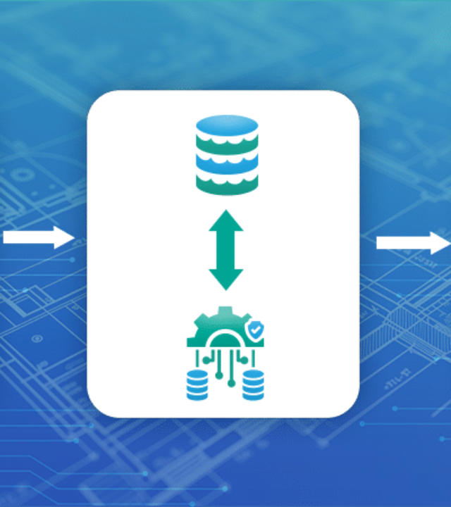
Pattern Analysis
Hybrid Communication
ShiftOps employs a dual interaction model to balance speed and reliability:
•
Synchronous REST: Used for Login and Compliance validation where immediate answers are required.
•
Asynchronous Events: Redis Pub/Sub handles Audit logging and Notifications to keep the UI responsive.

Slide 9
Flow: Schedule Publication
Manager Triggers
Compliance Gate
Data Written
Event Emitted
Async Finish
Generates schedule via Scheduling Svc
Sync call ensures Labor Act PASS
Schedule stored in Tenant Schema
Redis notifies Audit & Notification
Staff notified while UI remains fast

Slide 10
Agility and Efficiency Scaling
99.93%
Elastic Resource Management
The Scheduling Engine (OR-Tools) is computationally expensive but episodic. Microservices allow us to scale to zero during idle weekend periods, eliminating compute waste.
Updates to Bangladesh labor laws are applied via configuration files in the Compliance Service, requiring no system-wide redeployment.
Uptime Reliability Target

Slide 11

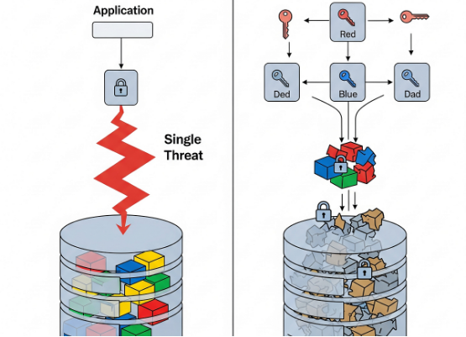
Multi-Tenant Security Model
Structural Data Isolation
ShiftOps utilizes a schema-per-tenant strategy in PostgreSQL. This creates a hard infrastructure boundary between hospitals.
Hospital A cannot see Hospital B data.
JWT-scoped role claims at the Gateway.
Non-repudiable emergency overrides.

Slide 12
Questions?
Thank you for your attention to the ShiftOps Architectural Strategy.
ShiftOps Platform | Secure & Scalable Healthcare Rostering

